Slide 1
Supplement to BRD 8: State Transition Diagrams
Eval Project 2015

Slide 2
Evaluator screens

Slide 3
1
This is disabled because it is in its first phase
Previous
Next
1
2
3
4
DRAFT
READY FOR TEACHER EVALUATION CONFERENCE
READY FOR TEACHER’S FORMAL RECEIPT
Report is final. Teacher can view the report in eVal and by doing so will acknowledge receipt of it
SUBMITTED
The finalized report has been submitted
Only visible to you.
Your report must be in DRAFT mode for you to score this teacher, add notes or adjust report settings for this evaluation report.
No further changes can be made to scores or report settings unless Report is returned to Draft.
x
Report will automatically submit once teacher logs into system and receives the it (recommended)
Evaluator over-rides:
No student growth scores included
x
Visible to teacher (default)
Submit my report NOW as I wish to finalize it without the teacher’s receipt
No electronic teacher acknowledgement of receipt
Not visible to teacher
I will use a paper process for signature and submission (an electronic copy showing it was “dropped to paper” will be automatically submitted as well)
Process was completed by paper
EVALUATOR SCREEN

Slide 4
If user clicks “Next”…
1A
Make report ready for Evaluation Conference?
(Select YES if you have finished entering the teacher’s annual scores and have finalized print settings. No further changes can be made unless the report is set back to Draft)
YES
NO
EVALUATOR SCREEN

Slide 5
If user clicks NO…
1A-1
User Action | Has information been entered for next year’s eVal cycle? | Have all 8 State Criteria been scored? | Have Student Growth scores been scored? | Then…
Clicks NO | N/A | N/A | N/A | Return user to Screen 1
Clicks YES | No | Doesn’t matter | Doesn’t matter | Present Message 1B, then return user to Screen 1
Clicks YES | Doesn’t matter | No | Doesn’t matter
Clicks YES | Yes | Yes | No | Present Message 1 C
Clicks YES | Yes | Yes | Yes | Go to Screen 2

Slide 6
1B
Your report cannot be finalized because the following information is missing:
x
You have not entered all required scores (an over-ride is available to exclude Student Growth scores; however, all other scores must be provided)
x
You have not provided the evaluation cycle information for next year’s evaluation
OK
EVALUATOR SCREEN

Slide 7
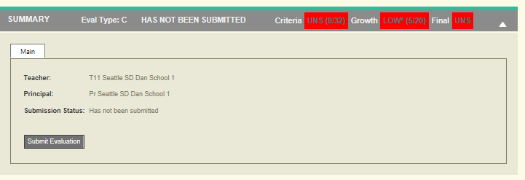
(note)
The new fields for next year’s evaluation cycle should go on the following panel which will now always remain open (and not be collapseable by user). If focused, the area of focus will display for current year and next year.

Slide 8
1C
Your report is missing Student Growth scores.
Option button default
X
My intent is to enter Student Growth scores (recommended)
I wish to over-ride the requirement of Student Growth scores and finalize this report without these scores. I understand that this is not the standard procedure; however, no scores are available at this time.
Over-ride explanation:
[Design note: If the second option is selected, then user must enter text into this box before they can leave this screen – they might get a pop-up saying this is required, or the text box can turn red, etc.]
OK
EVALUATOR SCREEN

Slide 9
Results from 1C User options
If user selects Option 1…
Then user should be returned to Screen 1
If user selects Option 2
And if user does not enter a description, then user cannot continue
If user enters a description, then user goes to Screen 2

Slide 10
2
Previous
Next
1
2
3
4
DRAFT
READY FOR TEACHER EVALUATION CONFERENCE
READY FOR TEACHER’S FORMAL RECEIPT
Report is final. Teacher can view the report in eVal and by doing so will acknowledge receipt of it
SUBMITTED
The finalized report has been submitted
Only visible to you.
Your report must be in DRAFT mode for you to score this teacher, add notes or adjust report settings for this evaluation report.
No further changes can be made to scores or report settings unless Report is returned to Draft.
x
Report will automatically submit once teacher logs into system and receives the report (recommended)
Evaluator over-rides:
No student growth scores included
x
Visible to teacher (default)
I will submit without teacher’s electronic receipt of the report
No electronic teacher acknowledgement of receipt
Not visible to teacher
I will use a paper process for signature and submission.
Process was completed by paper
EVALUATOR SCREEN

Slide 11
Note regarding Screen 2
When the report is moved to Phase 2, then the data WILL be visible to the teacher UNLESS the evaluator then selects “Not visible to Teacher” while on Screen 2. In this case, the data will remain invisible to the teacher unless either:
The evaluator selects Visible to Teacher; or
The report is moved to Phase 3 which is, by its nature, visible to the teacher

Slide 12
eVal Impact
We don’t need visibility settings anymore for Summary because the act of moving the report out of Draft will automatically set those settings.

Slide 13
If the user selects PREVIOUS…
2A
Move report back to Draft?
YES
NO
If selected, go back to Screen 1:
Report is no longer visible to teacher
If selected, go back to Screen 2
EVALUATOR SCREEN

Slide 14
If user clicks “Next”…
2B
Mark this version as the formal evaluation report for this teacher, now ready for Teacher’s receipt?
(Select YES if your review with the teacher is complete and you do not expect to make any further changes to the report. )
YES
NO
If selected, go to Screen 3:
(See TEACHER slides for further details)
If selected, go back to Screen 2
EVALUATOR SCREEN

Slide 15
3
Previous
Next
1
2
3
4
DRAFT
READY FOR TEACHER EVALUATION CONFERENCE
READY FOR TEACHER’S FORMAL RECEIPT
Report is final. Teacher can view the report in eVal and by doing so will acknowledge receipt of it
SUBMITTED
The finalized report has been submitted
Only visible to you.
Your report must be in DRAFT mode for you to score this teacher, add notes or adjust report settings for this evaluation report.
No further changes can be made to scores or report settings unless Report is returned to Draft.
x
Report will automatically submit once teacher logs into system and receives the report (recommended)
Evaluator over-rides:
No student growth scores included
x
Visible to teacher (default)
No electronic teacher acknowledgement of receipt
I will submit without teacher’s electronic receipt of the report
Not visible to teacher
I will use a paper process for signature and submission.
Paper evaluation was manually submitted
Report was moved marked final on:
April 15, 2015 @ 1:53:14 PM
EVALUATOR SCREEN

Slide 16
Results from Screen 3 User actions
Date should appear reflecting date/time that report was moved to Phase 3
If the user selects “Next” or if the user selects “I will submit without teacher’s electronic receipt of the report”….
Present user with Message 3A
If user selects “I will use a paper process for signature and submission”…
Present user with Message 3B

Slide 17
3A
You are requesting an over-ride that allows report submission without receiving electronic acknowledgement from the teacher that they have received their evaluation report. This is not the standard process.
Continuing with this option will immediately submit this evaluation report.
Over-ride explanation:
[Design note: If the second option is selected, then user must enter text into this box before they can leave this screen – they might get a pop-up saying this is required, or the text box can turn red, etc.]
If selected, Go to Screen 4
OK
Cancel
If selected, go back to Screen 3
EVALUATOR SCREEN

Slide 18
3B
You are requesting to move this evaluation out of the online eVal process to a paper form. Instead of storing the final report electronically with a digital representation of the teacher’s receipt, a PDF file will be provided to you that you can print for wet signature.
Continuing with this option will mark the existing electronic PDF as “submitted” with the “Drop to Paper” over-ride.
Over-ride explanation:
[Design note: If the second option is selected, then user must enter text into this box before they can leave this screen – they might get a pop-up saying this is required, or the text box can turn red, etc.]
If selected, Go to Screen 3C
If selected, go back to Screen 3
OK
Cancel
EVALUATOR SCREEN

Slide 19
3C
The user should receive the opportunity to save the finalized report as a PDF file. They can choose how to name it and where to save it.
Report has signature blocks with names printed for teacher and evaluator
Report includes audit field if student growth scores were not included
Report includes audit field showing that report was printed instead of the process being concluded in eVal
Once user creates PDF file, the user should be returned to Screen 4
Report is in Submitted state
The PDF file is flagged as ready for pick-up by the District the same as the other submitted PDF files
Any time the teacher or evaluator looks at the evaluation report or prints it from eVal, it will be this same version

Slide 20
If the user selects PREVIOUS…
3D
If you move this report back to the previous phase, it will not auto-submit when the teacher opens it, and you will have to move it back to this phase and have the teacher formally receive it again before it can be submitted.
CONTINUE?
YES
NO
If selected, go back to Screen 2. See Teacher Screen __
If selected, go back to Screen 3
EVALUATOR SCREEN

Slide 21
4
Previous
Next
This is disabled because it is in its final phase
1
2
3
4
DRAFT
READY FOR TEACHER EVALUATION CONFERENCE
READY FOR TEACHER’S FORMAL RECEIPT
Report is final. Teacher can view the report in eVal and by doing so will acknowledge receipt of it
SUBMITTED
The finalized report has been submitted
Only visible to you.
Your report must be in DRAFT mode for you to score this teacher, add notes or adjust report settings for this evaluation report.
No further changes can be made to scores or report settings unless Report is returned to Draft.
May 30, 2015
1:53:14 PM
x
Report will automatically submit once teacher logs into system and receives the report (recommended)
Evaluator over-rides:
No student growth scores included
x
Visible to teacher (default)
No electronic teacher acknowledgement of receipt
I will submit without teacher’s electronic receipt of the report
Not visible to teacher
I will use a paper process for signature and submission.
Paper evaluation was manually submitted
Reports are automatically set to this phase as soon as teacher acknowledges their report – see Teacher Screen T1
Report was moved marked final on:
April 15, 2015 @ 1:53:14 PM
These boxes would be set by the system (not the user) depending on whether the over-rides were used
EVALUATOR SCREEN

Slide 22
If the user selects PREVIOUS …
4A-1
You have requested to “Un-submit” a finalized, submitted report. Please contact your District Administrator for assistance.
OK
Anne -- I think we’ll need a way for a DA to un-submit an evaluation. (Donna)
EVALUATOR SCREEN

Slide 23
PRINTING THE REPORT – what the evaluator sees

Slide 24
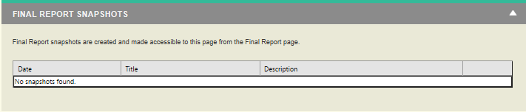
The “Snapshot” panel should change to “Print Evaluation Report”
With the lifecycle workflow, the Snapshot concept is no longer relevant. Instead, the user should be able to print the report from this panel (instead of it being referred to as a Snapshot). The report should list its current status. See Teacher Screen T1 for how it should look to the teacher when they print a report. Also, reporting settings should be per teacher, not per report type.

Slide 25
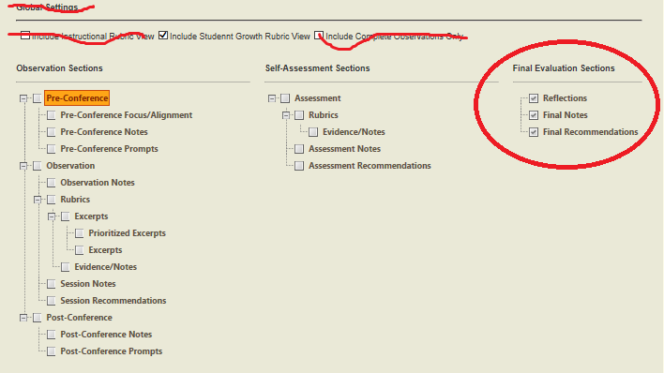
Report Settings
Report settings are per teacher per school year (not global); Reports are by State Critiera, including Student Growth scores.
“Final Evaluation sections” must show up on all reports (user cannot select to have or not have these fields on the report); however, data entry of these fields is not mandatory, In other words, a user may choose not to fill these fields out, in which case, no data will appear on the report. Consequently, we do not need to show these options on this panel.
“Observation Sections” and “Self-Assessment Sections” defaults to unselected. User can select them if they choose to do so.

Slide 26
Content that appears on the report, no matter which lifecycle phase or other report settings
OFFICIAL REPORT TITLE: “Seattle Public Schools Certified Teacher Summative Evaluation Form”
Teacher
Evaluator
School year
Current year’s evaluation cycle info and next year’s evaluation cycle info
User cannot complete the report without this information
State Criteria scores
User cannot complete the report without this information; however, user can use over-ride if Student Growth scores are missing
Report status (See next slide)
Audit fields
Final Evaluation Sections (Reflections, Final Notes, Final Recommendations)
If data is entered, then the section appears on the report. If no data is entered, then the section does not appear on the report.

Slide 27
Dynamic content on printed report, depending on lifecycle stage
If status is… | And if… | Report status on the report should appear as: | Audit fields for SG over-ride | Audit fields for electr ack over-ride | Audit fields for drop to paper | Audit fields for when teacher received report | Comments
DRAFT | n/a | Draft: Not submitted | n/a | n/a | n/a | n/a | (Teacher cannot print this)
Ready for Evaluation Conference | n/a | Ready for evaluation conference: Not submitted | Yes | n/a | n/a | n/a | Teacher can only print if evaluator made it visible to them
Ready for teacher’s receipt | Evaluator is printing it (i.e., the teacher has not yet opened it) | Waiting for teacher’s acknowledgement of receipt: Not submitted | Yes | No | No | n/a | Only the evaluator can print from this status, because as soon as the teacher opens the report when it is in this status, it changes to Submitted.
Submitted | n/a | Submitted | Yes | Yes | Yes | Yes | This is how the report will print from when the teacher opens the final version and for any printed versions thereafter by either teacher or evaluator

Slide 28
Signature Blocks
Condition | Print Signature Block?
Report is printed to screen (regardless of status and regardless of over-rides) | No
User has (1) selected “Drop to Paper” AND (2) has printed to PDF | Yes
User has printed to PDF under all other circumstances | No

Slide 29
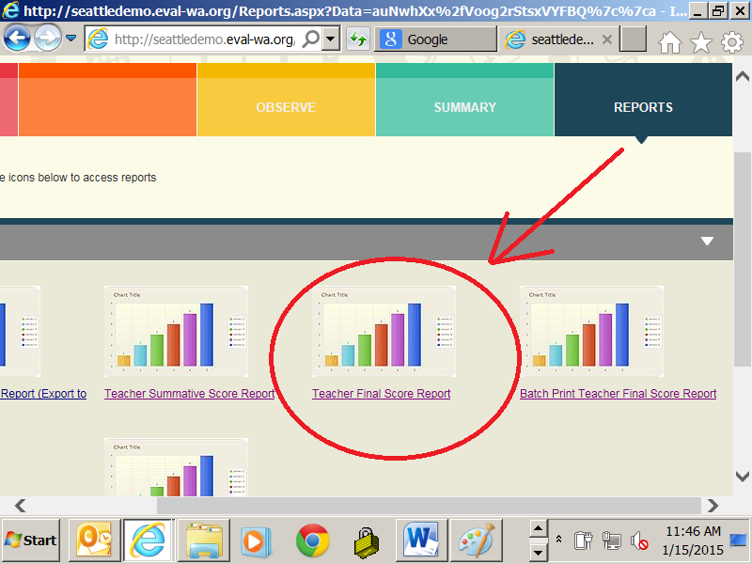
Rename how the report appears under Report Tab
The report is still available from the Reports Tab, but clearly identified so that the user understands this is the same report they created through the Summary panel and the workflow.
Report description that appears on the screen: “Teacher Summative Evaluation Form”

Slide 30
Teacher screens

Slide 31
PRINTING THE REPORT – what the teacher sees

Slide 32
T1: How the Teacher will print the report
See the next slide for all possible values. (This screen will not show an ongoing history. It will only show the most recent status.)
Evaluation Report
Status
Status Date
Action for you to take
Submitted
May 15 3:14:23
None. The report process is complete and the report has been submitted.
Print
It should print to screen first, then provide option for PDF file.
TEACHER SCREEN

Slide 33
T1 - Values
Status | Action for you to take | Corresponds to lifecycle phase | Notes
Not yet available | None at this time | 1 – Draft | Print button should be disabled
In progress | None at this time | 2 - Ready for evaluation conference if “not visible to teacher” is selected | Print button should be disabled
Ready for review at evaluation conference | Review and discuss at evaluation conference | 2 – Ready for evaluation conference – if “Visible to teacher” is selected (the default) | Print button should be enabled
Final report is ready for your receipt | Click Preview or Print above | 3 – Ready for teacher’s formal receipt | Print button is enabled; when clicked, present Teacher screen T2
Submitted | None. The report process is complete and the report has been submitted. | 4 – Submitted | Print button is enabled When clicked, the same content that was submitted is displayed to screen or ultimately selected by user as PDF file.

Slide 34
T2 – Pop up box (See previous slide for when this box is presented to user)
This content needs to be configurable by District since it will need to be approved internally by Legal and Labor teams
Acknowledgement of Receipt
You are now receiving your Summative Evaluation Form for this school year.
Close
User cannot escape out of this and there is no cancel button. The report prints to screen. From there, user can print to PDF if desired. Report status changes to “Submitted” , audit fields are updated and PDF file is created and ready for District pick-up.
TEACHER SCREEN

Slide 35
New DASHBOARDs

Slide 36
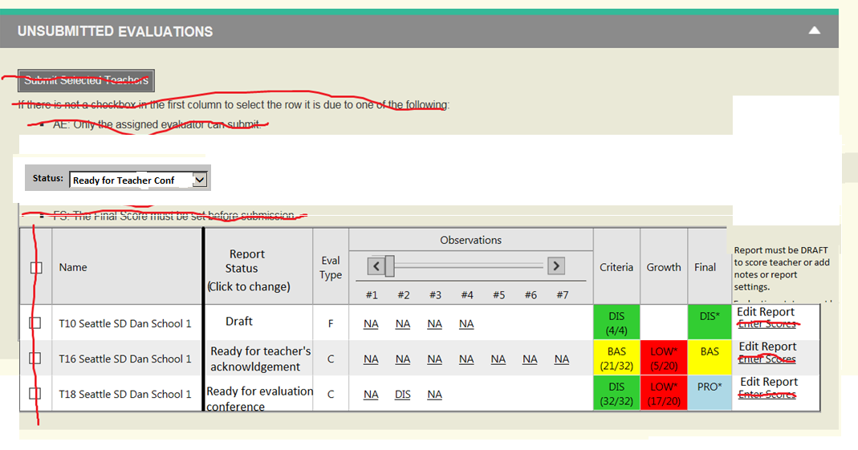
Navigation Dashboard (replaces existing navigation screen under the Summary tab)
5
New Filter
Build/view report
Build/view report
Build/view report

Slide 37
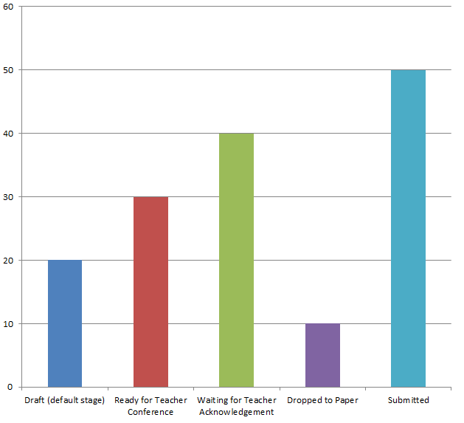


Suggested New Dashboard Available to all roles except Teacher
6
District-wide
Filter
Evaluator:
Mary Smith
Download
Excel file with underlying data including school names, evaluator names and teacher names (but no scores, just the workflow status)

Slide 38
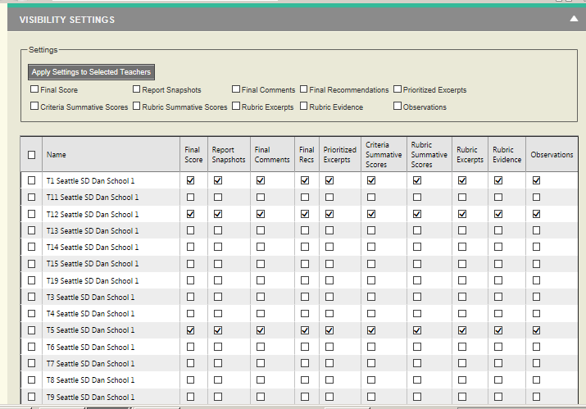
(Note - This panel no longer relevant)
The status of the report will determine which elements are visible to the teacher. When the report is in Draft, no elements are visible to the teacher, etc.

